Slide 1
Taking Over the World with F# Agents
Tomas Petricek tomas@tomasp.net | @tomaspetricek
Conspirator behind http://fsharp.org

Slide 2
software stacks trainings teaching F# user groups snippets mac and linux cross-platform books and tutorials
F# Software Foundation
F# community open-source MonoDevelop
http://www.fsharp.org
contributions research support consultancy mailing list

Slide 3

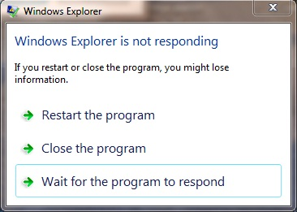
Asynchronous programming
On the server side
On the client side

Slide 4
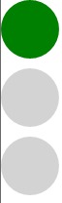
Async GUI programming
Controlling traffic light
Using int or enum to keep current state?
But – what does the state represent?
Better using asynchronous waiting
Loop that asynchronously waits for transitions

Slide 5
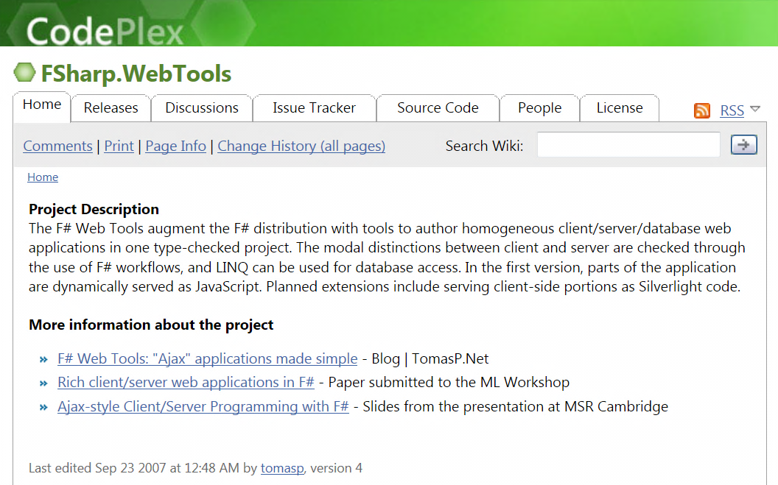

F# to JavaScript
Before it was cool.

Slide 6
F# to JavaScript
TypeScript type provider
Import types for JS libraries
Somebody else writes them!
Libraries & frameworks
Open source: FunScript and Pit
Commercial: IntelliFactory WebSharper

Slide 7
DEMO: Traffic lights

Slide 8
Writing loops using workflows
Using standard language constructs
Key idea – asynchronous waiting
C# – events are not first-class values
F# – can use functional style (recursion)
Infinite loop!
let semaphoreStates() = async {
while true do
for current in [ green; orange; red ] do
let! md = Async.AwaitEvent(this.MouseDown)
display(current) }
Wait for click

Slide 9
Drawing rectangles
Describes how drag & drop works
waiting
up
down
drawing
move

Slide 10
DEMO: Drawing rectangles

Slide 11
Async on the Server
Reactive model is important
Node.js and C# 5.0
F# asynchronous workflows
Keep standard programming model
Standard exception handling and loops
Sequential and parallel composition

Slide 12
Synchronous

Slide 13
Asynchronous

Slide 14
Synchronous code
Easy to write
Can use loops and exception handling
Blocks thread and does not scale!
var wc = new WebClient();
var html = wc.DownloadData(url);
outputStream.WriteAsync(html)

Slide 15
Event-based code
Makes code more scalable
Impossible to read & write by mere mortals
Can be surprisingly popular (Node.js)
var wc = new WebClient();
wc.DownloadDataCompleted += (s, e) =>
outputStream.BeginWrite
( e.Result, 0, e.Result.Length,
res => outputStream.EndRead(res), null);
wc.DownloadDataAsync(url);

Slide 16
(A)synchronous code
Easy to change, easy to write
Can use loops and exception handling
Scalable – no blocking of threads
var wc = new WebClient();
var html = await wc.DownloadDataTaskAsync(url);
await outputStream.WriteAsync()
var wc = new WebClient();
var html = wc.DownloadData(url);
outputStream.WriteAsync()

Slide 17
Async workflows in F# and C#
C# – Return Task and add async and await
F# – Wrap in async and use let! keyword
async Task<int> PageLength(Uri url) {
var wc = new WebClient();
var html = await wc.DownloadStringTaskAsync(url);
return html.Length;
}
let pageLength (url:Uri) = async {
let wc = new WebClient();
let! html = wc.AsyncDownloadString(url)
return html.Length }

Slide 18
DEMO: Asynchronous proxy

Slide 19
Agent-based programming
Program consists of agents
Lightweight – can create lots of them
Written using asynchronous workflows
Agents communicate via messages
Communication is thread-safe
Messages are queued
Enables parallelism
Different agents vs. multiple instances

Slide 20
Simple agent in F#
Send “Hello” to the caller
Waiting for message is asynchronous
Can perform long-running I/O before replying
Calling agent asynchronously
let echo = Agent.Start(fun agent -> async {
while true do
let! name, rchan = agent.Receive()
rchan.Reply("Hello " + name) })
let! str = echo.PostAndAsyncReply(fun ch -> "Tomas", ch)

Slide 21
DEMO: Proxy with caching

Slide 22
Multi-state agents
Accepting all messages
Asynchronously Receive and use pattern matching
Waiting for a specific message
Other messages stay in the queue
Agent.Start(fun agent ->
let rec blocked = agent.Scan (function
| Resume -> Some (async {
printfn "Resumed!"
return! running })
| _ -> None)
and running = (* ... *) )
Run workflow when Resume arrives
No response specified for other messages

Slide 23
DEMO: Pausing Twitter

Slide 24
DEMO: Batch processing

Slide 25

New books & trainings
F# Trainings & Progressive Tutorials
In London and New York
Get in touch: tomas@tomasp.net
F# Deep Dives book
Concurrency (Gaming, finance)
Business logic (Insurance, …)
Data (Research, Machine learning)
Testing (Finance, …)
Early access at: http://manning.com/petricek2

Slide 26
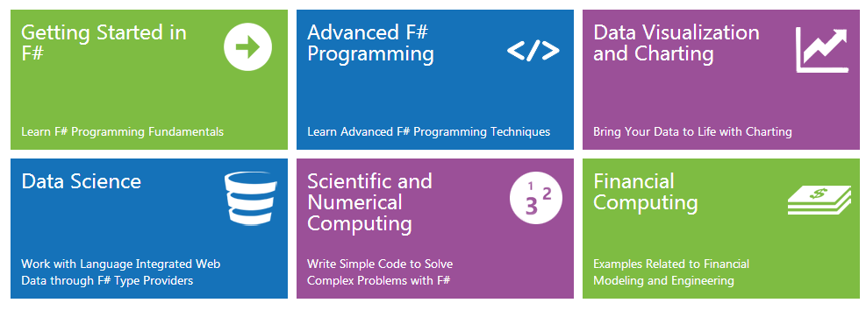
Online resources
www.fsharp.org Information & community www.tryfsharp.org Interactive F# tutorials

Slide 27
Summary
First-class async support
Available in F# now (and in C# 5.0)
Allows interesting patterns
Both server-side and client-side
F# has a few more things (agents, …)
Easy interoperability from C#

